Slide 1
TEMPERATURE MEASUREMENT
INTRODUCTION
Temperature measurement in today’s industrial environment covers a wide variety of needs and applications.
To meet this demand, the process control industry has developed a large number of sensors and devices to handle this demand

Slide 2
Introduction…
Temperature is a critical and widely measured variable for most engineering system control. May processes have either a monitoring or controlled temperature.
This can range from a simple monitoring of temperature say, water temperature of an engine or load device or as complex as temperature in welding practices.

Slide 3
Intro…
More difficult measurement such as the temperature of smoke stack gas from power generating plant or blast furnace or exhaust gas of rocker may require monitoring.
Much more common are the temperature of fluids in processes or temperature of solid objects such as metal plates, bearings and shafts in machinery.

Slide 4
WHAT IS TEMPERETURE ?
The temperature of a medium is an expression of its content of thermodynamic energy.
The thermodynamic energy represents the average velocity of the unarranged molecular movement in the material.
In other words, temperature is a physical property of matter that expresses how hot and cold it is.

Slide 5
Principles of temperature measurement
The principle of measuring temperature depend upon the type of device being used, the accuracy required, whether is for monitoring or control and whether you can touch it or not These measuring devices infer temperature by sensing some changes of physical characteristics of body.

Slide 6
Temperature measuring devices
The temperature measuring devices are categorized into FOUR:
  Mechanical devices
  Thermocouples devices
  Thermo resistive devices
  Radiative devices

Slide 7
Description of temperature measuring devices
1. Mechanical temperature measuring device.
A change in temperature causes some kind of mechanical motion typically due to the fact that most material expand with the rise in temperature.
Mechanical thermometers can be constructed which use liquids, solids, or even gases as temperature sensitive material.

Slide 8
Mechanical temperature measuring device cont………
The mechanical motion is read on a physical scale to infer the temperature. The example includes;
liquid-in glass thermometer
The most common and well known thermometer is the liquid in glass thermometer. As the temperature rises the liquid expands, moving up the tube. The scale is calibrated to read temperature directly.

Slide 9
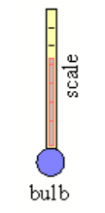
Liquid –in glass thermometer

Slide 10

Mechanical temperature measuring device cont……
Bimetallic strip thermometer
Two dissimilar metals are bonded together into what is called a bimetallic strip as shown in fig. below

Slide 11

Suppose metal A has smaller thermal coefficient of expansion than metal B does. As temperature increases metal B expand more than metal A does causing the bimetallic strip to curl upwards as shown in figure below.

Slide 12
2. Thermocouples
A thermocouple is made up of two dissimilar metals, joined together at one end that produce a voltage (in mV) with change in temperature. The junction of the two metals, called the sensing junction is connected to extension wires. Any two dissimilar metals may be used to make a thermocouple

Slide 13
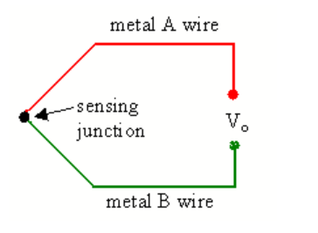
Thermocouple …………
The figure below shows a simple circuit thermocouple

Slide 14
Principle of operation of a thermocouple
When two dissimilar metals are connected together, a small voltage called thermo-
junction voltage is generated at the junction.
If the temperature of the junction changes (a linear change) causes voltage to changes too, which can be measured by the input circuits of an electric controller.

Slide 15
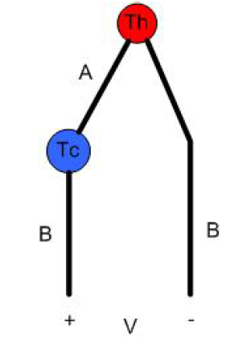
Thermocouple cont…
The output is a voltage proportional to the temperature difference between the junction and the free end.

Slide 16
3. Thermo resistive temperature measuring device
A change in temperature causes the electrical resistance of material to change. The resistance change is measured to infer temperature change.
There are two types of thermo-resistive devices.
(i) Resistance Temperature Detector (RTD)
(ii) Thermistors

Slide 17
3.1. Resistance Temperature Detector
A resistance temperature detector is basically a long, small diameter metal wire wound in a coil.
Principle of operation.
Resistance Temperature Detector (RTD) operates in the principle of electrical resistance of a metal which changes predictably in an essential linear and repeatable manner which changes in temperature. The RTD has a positive temperature coefficient (resistance increases with temperature).

Slide 18
Principle of operation cont…
The resistance of the element at the base temperature is proportional to the length of the element and inverse to the cross sectional area.
A typical electrical circuit designed to measure temperature with RTD actually measures a change in resistance of the RTD which is then used to calculate a change in temperature.
The resistance of the RTD increases with increasing temperature.

Slide 19
3.2. Thermistors
These are temperature sensitive semiconductors that shows a large change in resistance over a relatively small range of temperature.
There are two types of thermistors namely;
(i) Positive Temperature Coefficient-PTC
(ii) Negative temperature Coefficient-NTC

Slide 20
Thermistors cont..
The Negative Temperature Coefficient (NTC) thermistors shows a characteristic of resistance falling with increase in temperature. These are commonly used for temperature measurement.
The Positive Temperature Coefficient will show the raising of resistance with increase in temperature.

Slide 21
4.Radiative temperature measuring device
Two types of radiative measuring device are used;
(i) infrared pyrometer (ii) optical pyrometers.
Infrared temperature sensors are also known as pyrometer or non-contact temperature sensor are used to measure the temperature of an object without contact.
This is different from most temperature measuring devices which require direct contact with the measured media.

Slide 22
Radiative device cont..
Non contact method of temperature measurement are advantageous where contact method is impossible or impractical such as when the target is inaccessible or so hot that the contact device will not survive.

Slide 23
Operation principle
Infrared temperature sensors uses the principle of object emits an amount of energy that is a function of its temperature.
This function dictates that as the temperature of an object rises, so does the amount of energy it emits.
An infrared temperature sensor determine temperature by sensing the intensity of energy given off by an object.

Slide 24
Optical pyrometer
An optical pyrometer is useful for measuring very high temperature (even flame).
The optical pyrometer uses an infrared radiation sensitive sensor, e.g. a photodiode or photo- resistor to compare the radiation from the unknown with that from the source.

Slide 25
Optical cont..
The accuracy of the optical pyrometer is very much a function of the emissivity of the device that is radiating the heat.
The obvious advantage of using optical pyrometer at very high temperature is that it can measure in a non contacting media.

